Slide 1
Mini Project - 2

Slide 2
Analyzing and Visualizing Regional Sales Performance

Slide 3
Introduction in Domain
Retail Sales Analytics involves analyzing sales data to gain insights into customer behavior, product performance, and market trends. It helps businesses optimize pricing, inventory, and marketing strategies. By leveraging data-driven decisions, retailers can enhance profitability and customer satisfaction.
Project Introduction
(Analyzing And Visualizing Regional Sales Performance)
This project aims to analyze sales performance data for ABC Electronics by assessing regional and product category trends. The goal is to provide actionable insights through data cleaning, analysis, and a visual dashboard.
Objective
To clean and organize sales data for accurate analysis.
To identify top-performing regions and product categories using Excel formulas and Pivot Tables.
To create a visual dashboard that provides actionable insights for decision-making.

Slide 4
ELT Approach
(Extract, Load, Transform) approach was implemented using Excel as follows:
Extract:
Sales data was imported into Excel from sources like CSV files, databases, or reports.
The Data tab in Excel with the Get Data feature was used for importing data from external sources.
Load:
The extracted data was loaded into Excel tables for structured viewing and easy manipulation.
Multiple sheets were used to organize data efficiently.
Transform:
Data cleaning tasks such as removing duplicates, handling missing values, and formatting columns were performed using functions like Remove Duplicates and Text to Columns.
Additional columns were created using Excel formulas (IF, VLOOKUP, AVERAGE, SUMIF) to generate insights.
Pivot Tables and Pivot Charts were used for summarizing and visualizing regional sales performance.
This ELT process in Excel provided a user-friendly and effective way to analyze and visualize sales data for better decision-making.

Slide 5
Data Migration
Data migration from MongoDB to SQL involves transferring data from a NoSQL database (MongoDB) to a relational database (SQL). Here's how it typically works:
Extract:
Data is extracted from MongoDB using tools like MongoExport or Python scripts with libraries like pymongo.
JSON or CSV formats are often used for easy data transfer.
Transform:
During extraction, data may need to be normalized since MongoDB uses a flexible, schema-less structure, whereas SQL requires a well-defined schema.
Data cleansing and conversion may also occur using ETL tools or custom scripts.
Load:
The transformed data is then imported into SQL databases like MySQL, PostgreSQL, or SQL Server.
SQL’s bulk insert operations, SQLAlchemy (for Python), or tools like SSIS or DataGrip can be used for loading.
This migration enables efficient querying using SQL and supports further analysis and visualization using tools like Excel or Power BI.

Slide 6
Exploratory Data Analysis (EDA)
Data Cleaning: Fixing errors, removing duplicates, and handling missing values.
Descriptive Analysis: Using functions like SUM and AVERAGE to calculate sales and profits.
Visualization: Creating charts and pivot tables to view sales trends.
Trend Identification: Spotting sales patterns, regional differences, and the effect of discounts.
EDA helps in understanding data for better decision-making.

Slide 7
Feature Engineering
Handle missing data (impute or remove)
Encode categorical variables (One-Hot, Label, or Target Encoding)
Scale and normalize data (Min-Max, Standardization, or Log Transform)
Create new features (Polynomial, Interaction, or Aggregation)
Extract features using techniques like PCA or TF-IDF
Generate date and time features (day, month, year, time differences)
Build domain-specific features (e.g., Profit = Revenue - Cost)
Convert continuous data into categories (Binning)
Remove redundant features (using correlation or low variance)
Tools
Python: Pandas, NumPy, Scikit-Learn
Excel: Formulas, Pivot Tables, Power Query
SQL: Data extraction and transformation

Slide 8
Statistical technique
T-Test: Compare means of two groups.
ANOVA: Compare means of three or more groups.
Chi-Square Test: Check relationships between categorical variables.
Correlation Test: Measure strength and direction of relationships.
Regression Test: Predict outcomes using linear or logistic models.
Z-Test: Compare means when sample size is large.
F-Test: Compare variances between groups.

Slide 9
Conclusion:
The analysis and visualization of regional sales performance revealed several key insights:
Top-Performing Categories and Regions: Clothing and Electronics emerged as the most profitable categories, with the East and North regions contributing significantly to overall sales and profit.
Impact of Discounts: While discounts boosted sales volume, they also reduced profit margins, especially in the Groceries and Sports categories.
Sales Trends: Seasonal and regional variations were evident, with certain regions performing consistently better across all categories.
Profitability Insights: High-profit margins were observed in categories with lower discount rates, suggesting opportunities for pricing optimization.
These findings can help stakeholders make data-driven decisions to optimize sales strategies, adjust discount policies, and focus on high-margin categories for increased profitability.

Slide 10
Business Suggestions/Solutions
Optimize Pricing and Discount Strategy:
Reduce excessive discounts on low-margin categories like Groceries and Sports.
Implement targeted discounts for high-margin categories like Clothing and Electronics to maximize profits.
Focus on High-Performing Regions:
Allocate more resources and marketing efforts to the East and North regions, which show strong sales and profitability.
Identify and address challenges in low-performing regions to boost sales.
Product Portfolio Management:
Promote profitable product categories through special promotions or bundled offers.
Regularly analyze product performance to discontinue underperforming items.
Enhance Customer Targeting:
Implement personalized marketing campaigns using insights from regional preferences and customer behavior.
Offer loyalty programs and incentives to high-value customers.
Data-Driven Decision-Making:
Continuously monitor sales and profit trends using dashboards and reports.
Perform periodic analysis to adjust strategies based on market demand and regional performance.

Slide 12
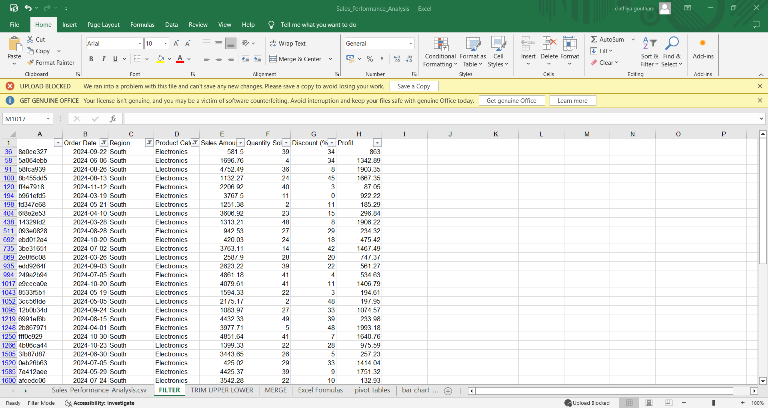
Task 1

Slide 13
Filter by Region (South)
Click the dropdown arrow in the Region column.
Uncheck Select All.
Check only South.
Filter by Category (Electronics)
Click the dropdown arrow in the Category column.
Uncheck Select All.
Check only Electronics.
Filter by Date (Within the Last Year)
Click the dropdown arrow in the Order Date column.
Select Date Filters → Custom Filter.
Choose is after or equal to.
Enter the date that is 365 days before today.
You can calculate this using =TODAY()-365 in an empty cell to get the exact date.
Click OK.

Slide 14
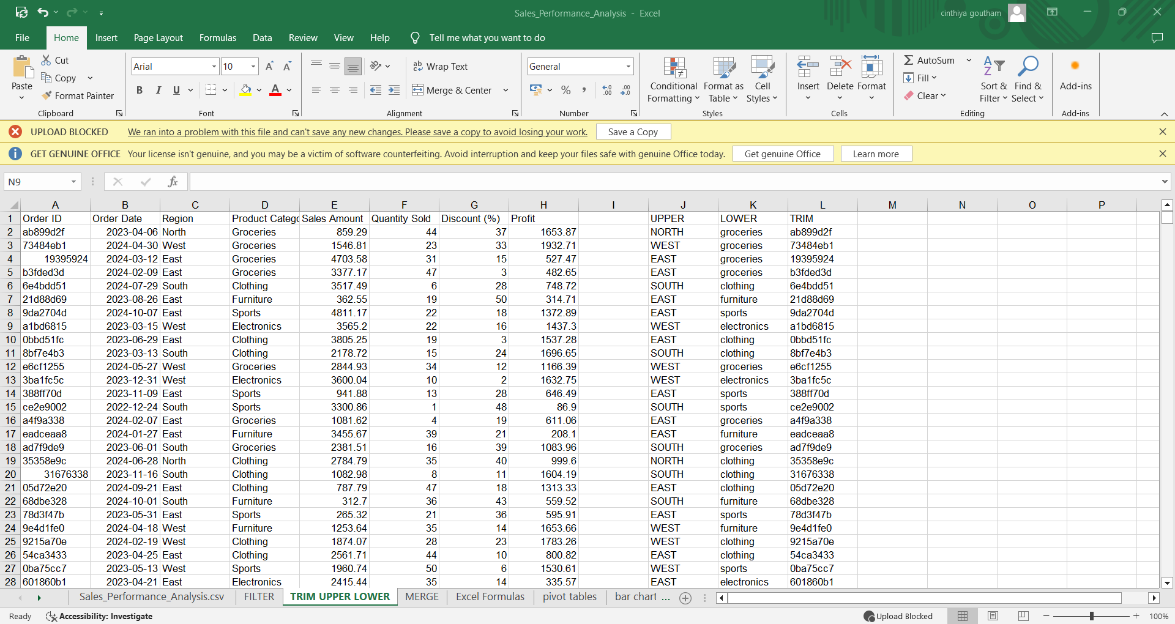
Task 2

Slide 15
TRIM(): Removes extra spaces from text, leaving only single spaces between words.
UPPER(): Converts text to uppercase.
LOWER(): Converts text to lowercase.

Slide 16
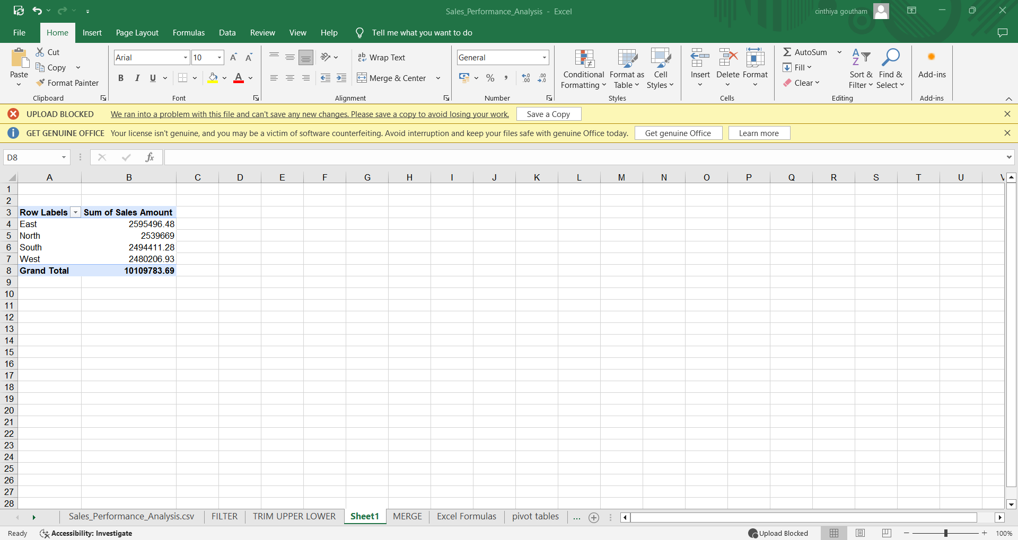
Task 3

Slide 17
Create a Pivot Table
Select your dataset (ensure it has headers like Region and Sales Amount).
Go to Insert → PivotTable → New Worksheet.
Region → Rows
Sales Amount → Values (Set it to Average if not already).
This will display the average sales amount for each region

Slide 18
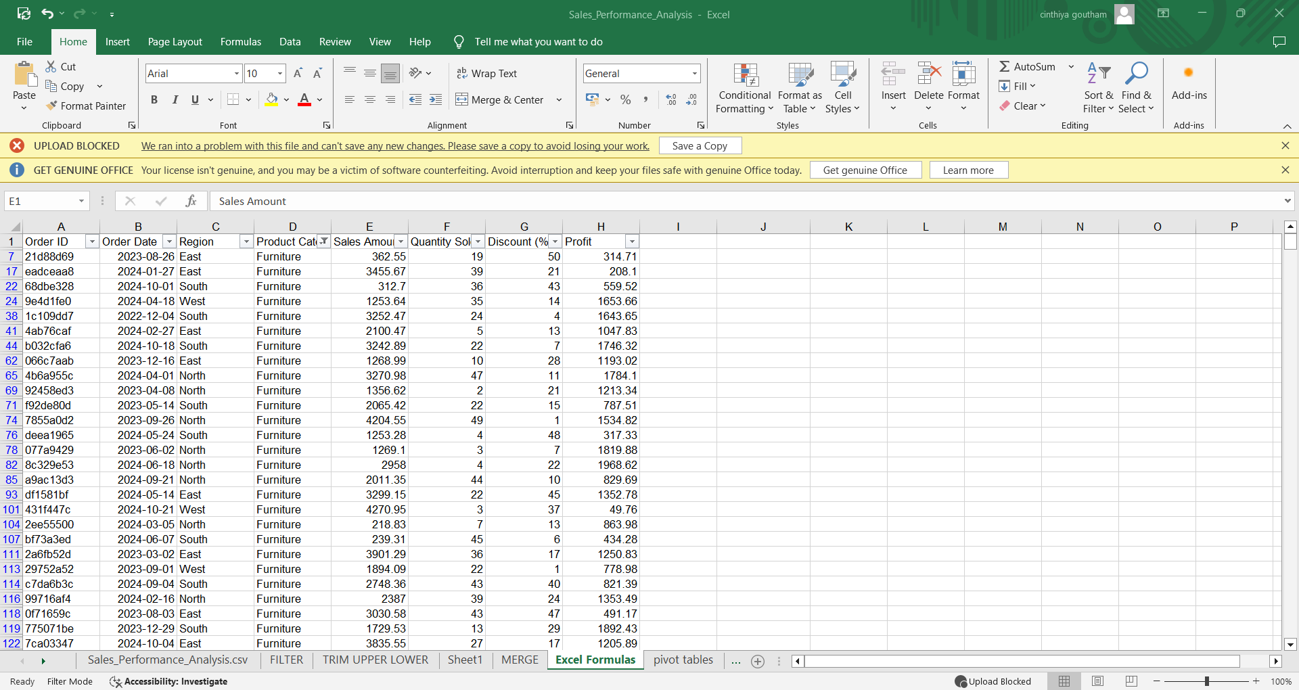
Task 4

Slide 19
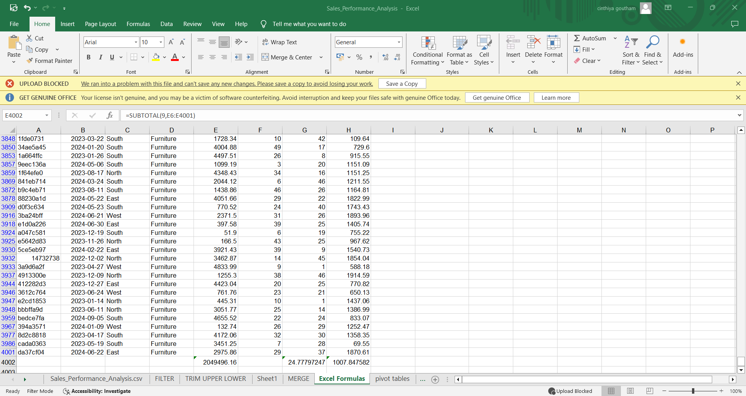

Slide 20
The Excel file Sales_Performance_Analysis.csv contains sales data with columns like Order ID,
Date, Region, Category, Sales,Quantity, Profit, and Discount.
The user is applying formulas, specifically calculating the average
using =AVERAGE(G7:G4001) for the Quantity column. Various options are available for data analysis,
including filtering,using pivot tables, creating charts, and applying conditional formatting for insights.

Slide 21
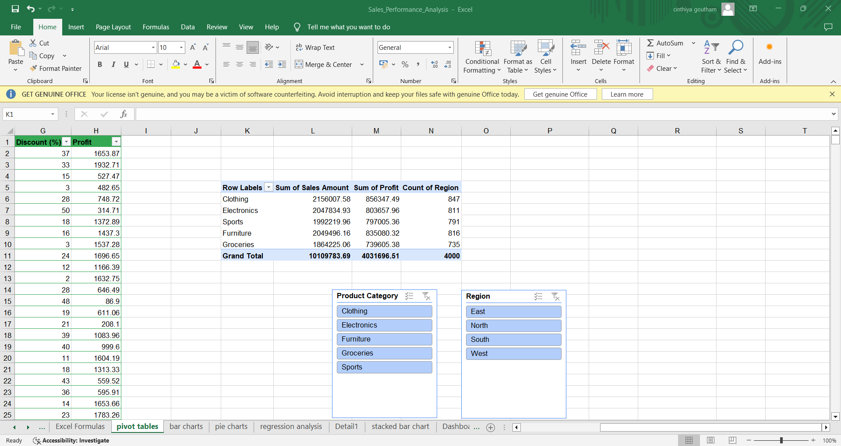
Task 5

Slide 22
This Excel sheet displays a Pivot Table analysis for sales data.
The table summarizes Sales Amount, Profit, and Count of Region for different product categories (Clothing, Electronics, Sports, Furniture, Groceries).
The Grand Total of Sales is 10,109,783.69, and the Total Profit is 4,031,696.51 across 4,000 regions.
Slicers for Product Category and Region are present, allowing easy filtering and visualization.
This setup is useful for dynamically analyzing sales and profit data based on product categories or regions.

Slide 23
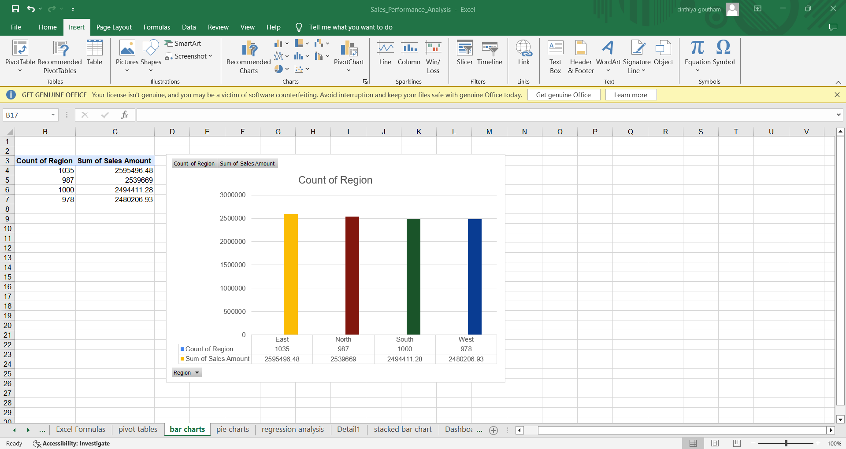
Task 6
Bar chart

Slide 24
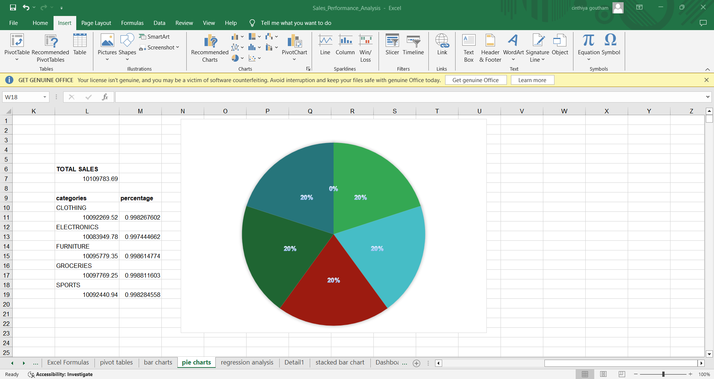
Pie chart

Slide 25
Bar chart
The Count of Region and the Sum of Sales Amount for four regions: East, North, South, and West. The chart uses different colored bars to represent each region's data. A summary table on the left displays the exact values for both the count and sales amount. The chart visually represents regional sales performance.
Pie chart
A pie chart in Excel representing sales data across different categories: Clothing, Electronics, Furniture, Groceries, and Sports. Each category is shown as a segment of the pie, with the percentages displayed. The sales amounts and corresponding percentages are listed in a table on the left, with a Total Sales value of 10,109,783.69. The chart is well-structured to provide a clear visual representation of the contribution of each category to the total sales.

Slide 26
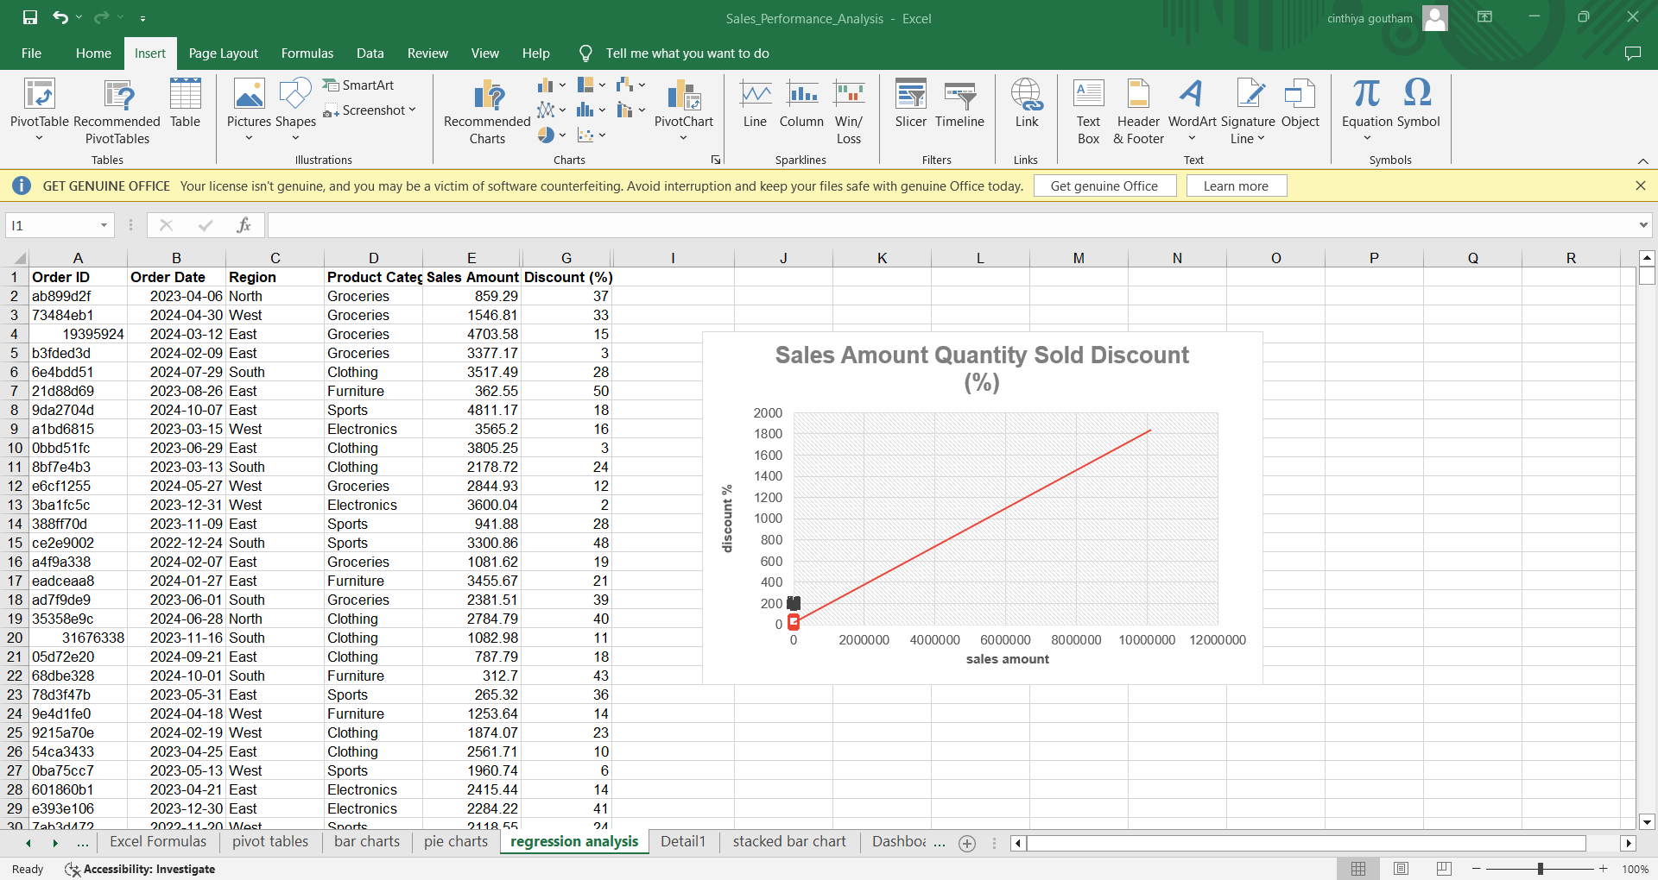
Task 7

Slide 27
The chart is titled "Sales Amount Quantity Sold Discount (%)" but it primarily shows the relationship between Sales Amount and Discount (%).
The line appears as a perfectly linear plot, which is unusual.
This may be due to incorrectly plotted data points.
You might want to use a Scatter Plot instead of a Line Chart.
To visualize actual data points more effectively.

Slide 28
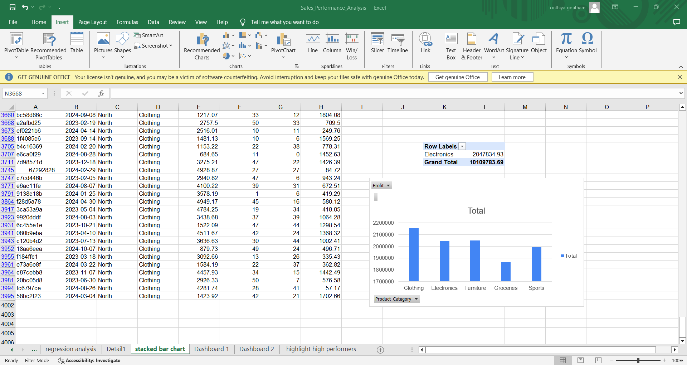
Task 8

Slide 29
Select any cell within the Pivot Table.
Go to the Insert tab → Charts → Bar Chart → Choose Stacked Bar Chart.
The chart visualizes the total sales across different product categories
Clothing, Electronics, Furniture, Groceries, and Sports).
The chart title is "Total," and the Y-axis represents sales values.
It seems to be a simple bar chart, not a stacked bar chart.
If you intended to create a stacked bar chart, you might need to adjust the chart type.

Slide 30
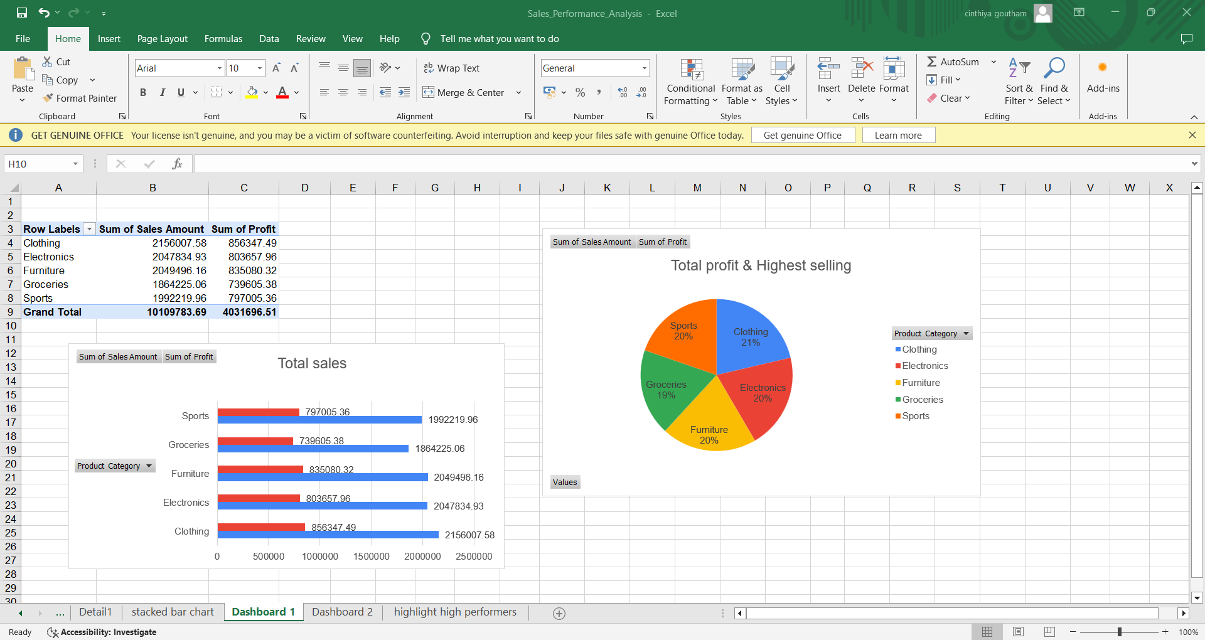
Task 9

Slide 31
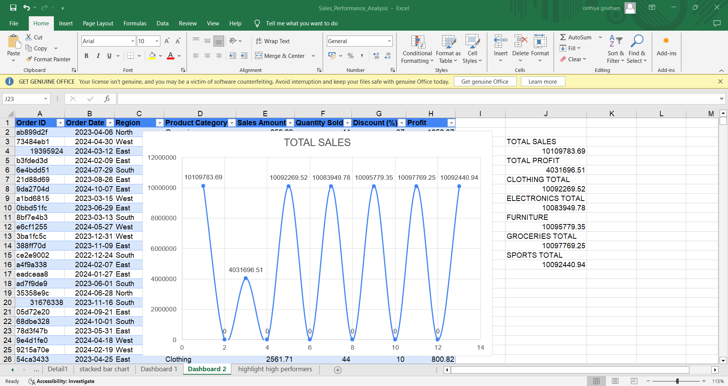

Slide 32
Dashboard in Excel that summarizes sales and profit data by product category.
On the left, there is a Pivot Table displaying the Sum of Sales Amount and Sum of Profit for categories like Clothing, Electronics, Furniture, Groceries, and Sports. The grand total values are 10,109,783.69 for sales and 4,031,696.51 for profit.
Below it, a horizontal bar chart visualizes the sales and profit for each category, using blue for sales and red for profit.
On the right, a pie chart represents the proportion of total sales by product category. The chart highlights that Clothing holds the largest share (21%), followed by Electronics, Furniture, Groceries, and Sports, all around 20%.
The dashboard offers a clear visual comparison of sales and profit performance across categories, making it easy to identify top-selling and most profitable categories.
This Excel dashboard (Dashboard 2) shows a line chart representing total sales across
different product categories.
The x-axis represents the categories (Clothing, Electronics, Furniture, Groceries, Sports),
and the y-axis shows the sales amounts.The line fluctuates to indicate the total sales and profit
values for each category.
On the right, a summary table lists the Total Sales (10,109,783.69) and Total Profit
(4,031,696.51) along with the sales values for each product category.
The dataset below the chart contains detailed information on Order ID, Order Date, Region,
Sales Amount, Quantity Sold, Discount, and Profit.
This chart is useful for identifying category-wise sales trends and comparing profitability.

Slide 33
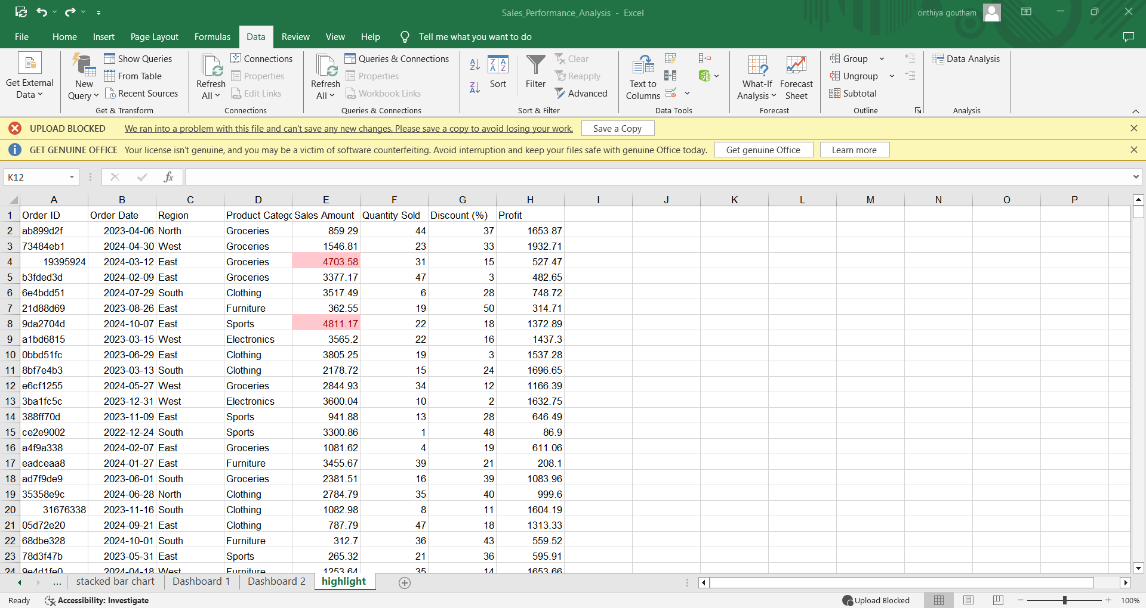
Task 10

Slide 34
The sheet shows sales data with fields like Order ID, Region, Product Category, Sales Amount, Quantity Sold, Discount (%), and Profit.
Some cells in the Sales Amount column are highlighted, likely representing high sales.
The yellow highlight may indicate high performers based on sales amount.

Slide 35
Result
Analyze sales data for ABC Electronics by cleaning and organizing it. Use Excel formulas and Pivot Tables to identify top-performing regions, products, and trends. Create a clear dashboard with visual insights for actionable decision-making.

